Slide 1

D Power System Inc’s. Software Development for ERP System
Innovative Solar Solutions with AI Technology

Slide 2
Company Overview
DNS specializes in solar installations, R&D of solar inverters, & AI-based power management systems.
Our goal is to bring innovative & efficient solar energy solutions to homes & businesses across Canada.
https://ca.linkedin.com/in/d-power-solutions-inc
https://www.instagram.com/d_powersolutions/
https://homestars.com/companies/2971507-d-power-solutions-inc

Slide 3
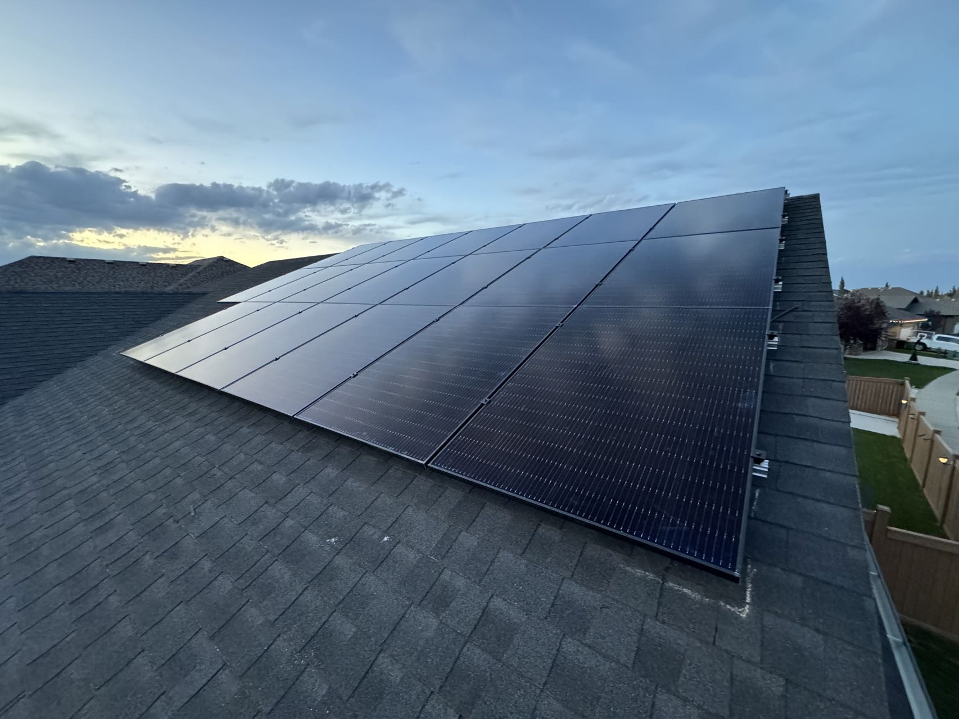
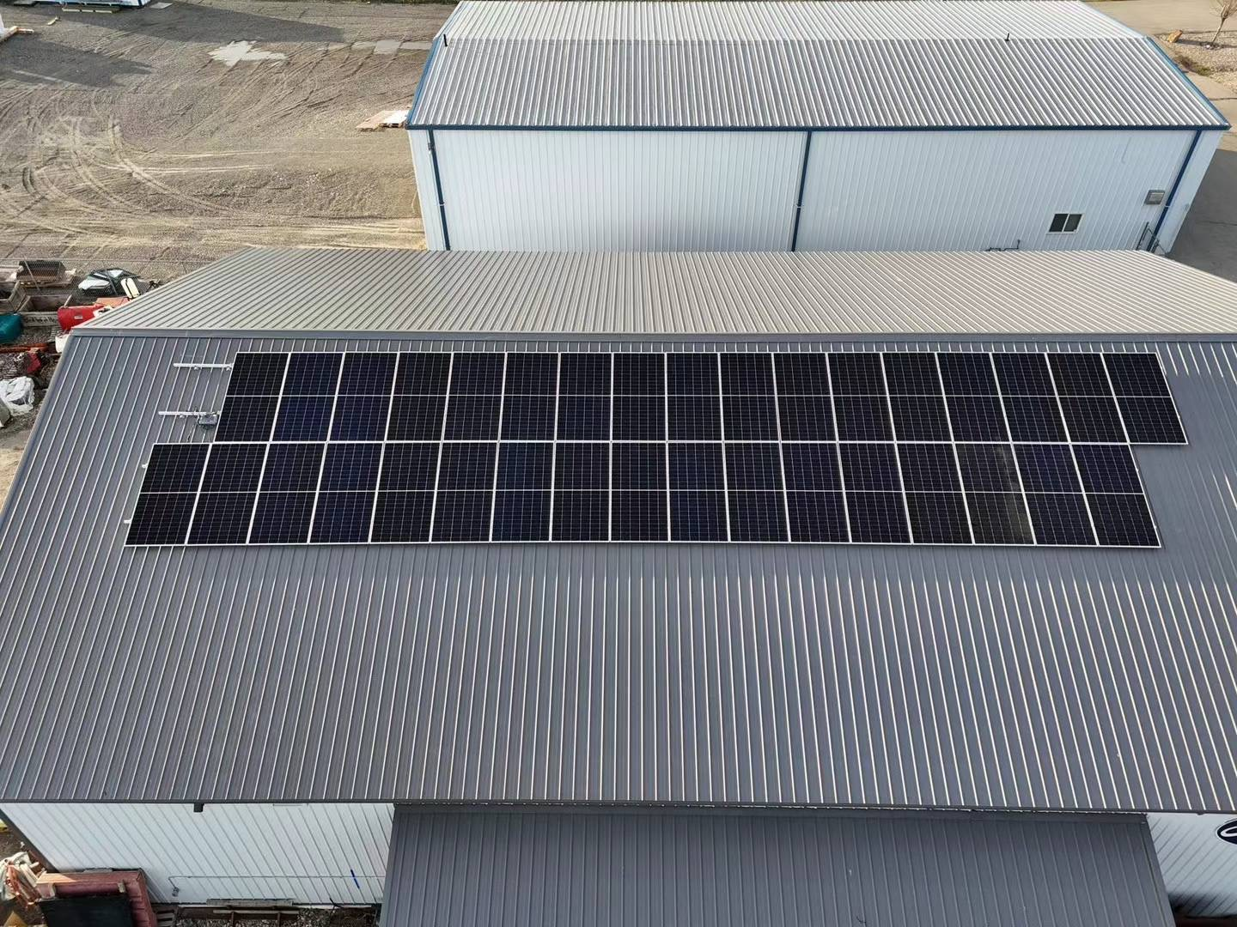
Our Services
• Residential/Commercial Solar Installations
• Solar Inverter Design and Innovation
• AI-based Energy Efficiency Solutions
• Custom Solar Panel Systems Design
• Solar Maintenance, Support & Provisioning

Slide 4
Key Technologies
• Solar Energy Management w/ AI
• Efficient Solar Inverter Design
• Innovative Machine Learning Applications
• Smart Power Solutions for Maximum Efficiency

Slide 5
Why Choose Deep Neural Solar?
• Experienced in Solar and AI Technologies
• Innovative Approach to Energy Management
• Custom Solutions Tailored to Your Needs
• Committed to Sustainable and Renewable Energy

Slide 6
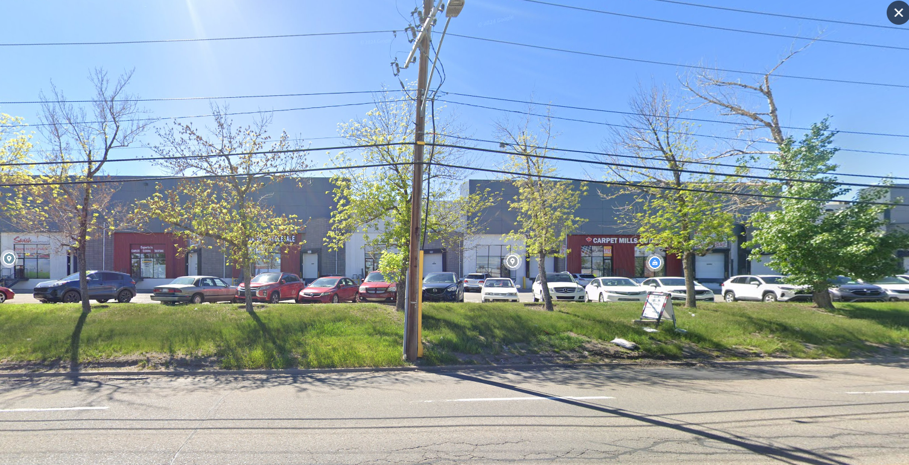
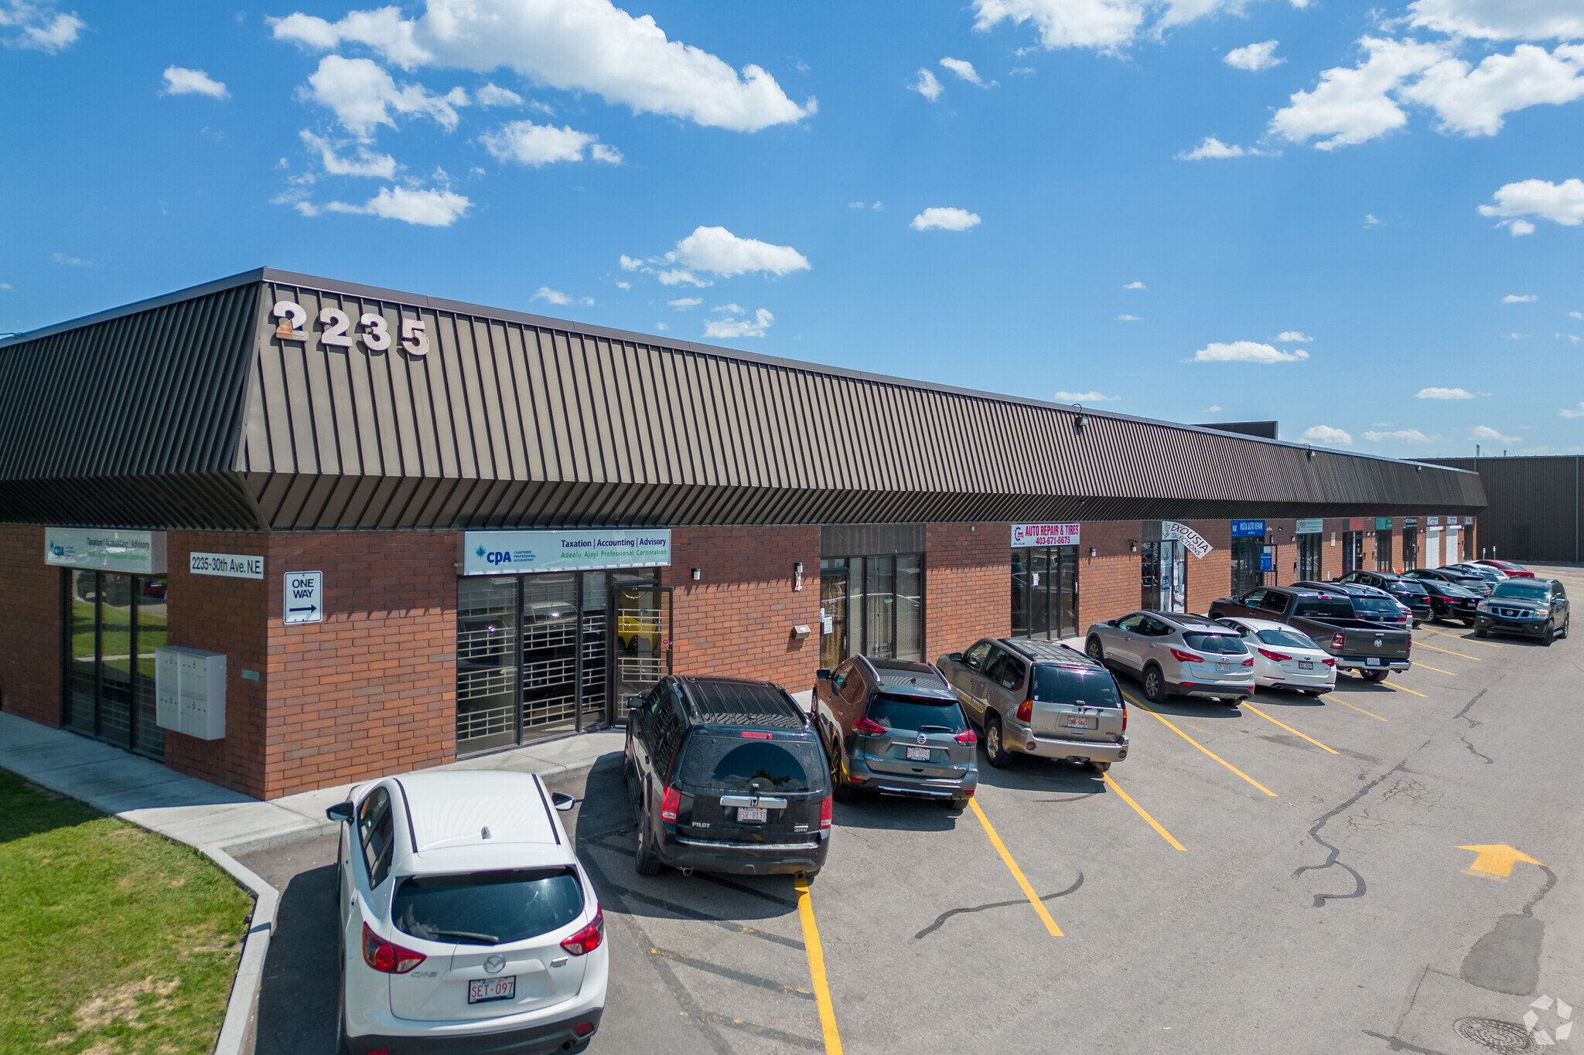
Locations
Warehouses Locations
Headquarter: Unit 11, 2235 30Th Ave NE, Calgary
Warehouse: 611 28 St NE, Calgary

Slide 7
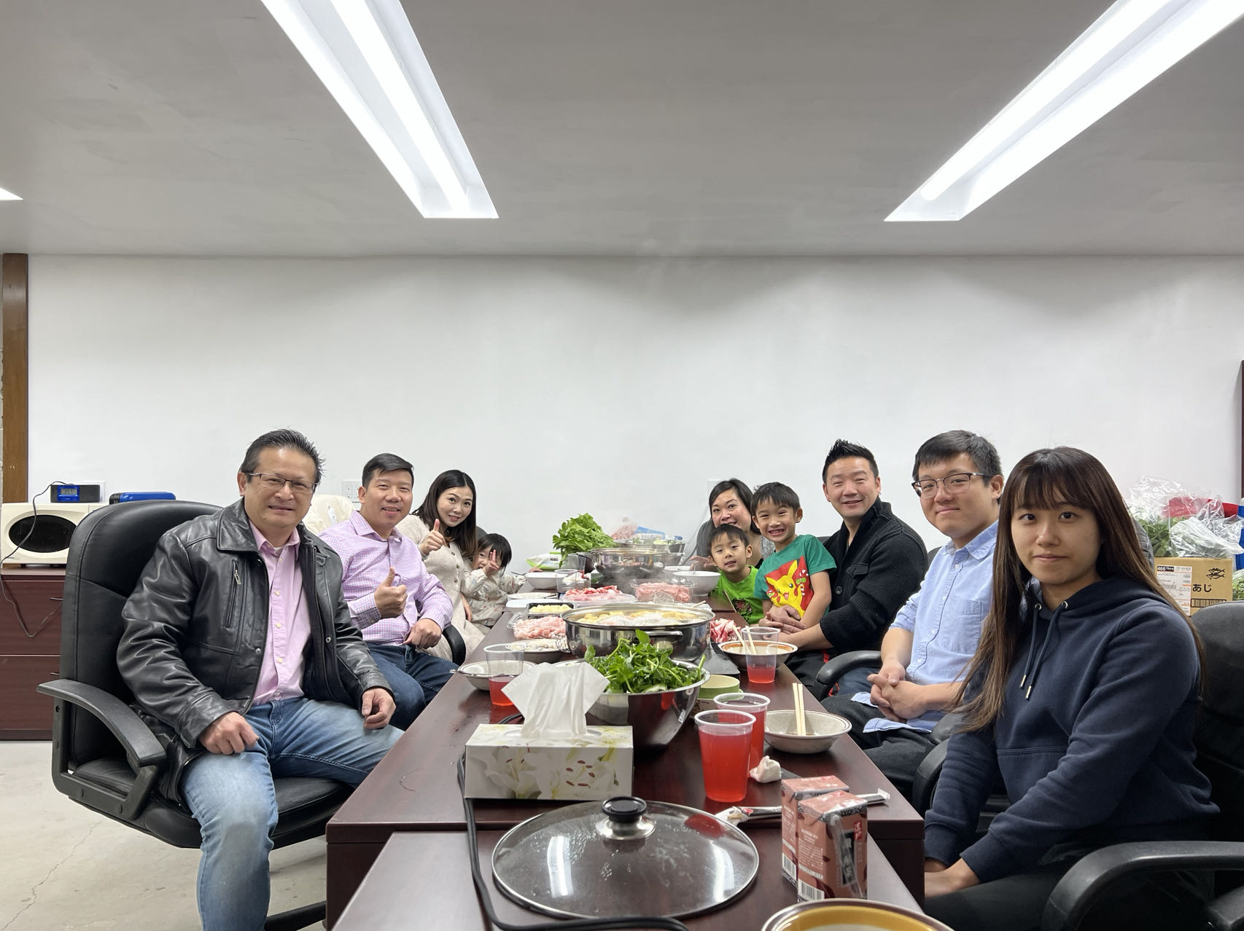
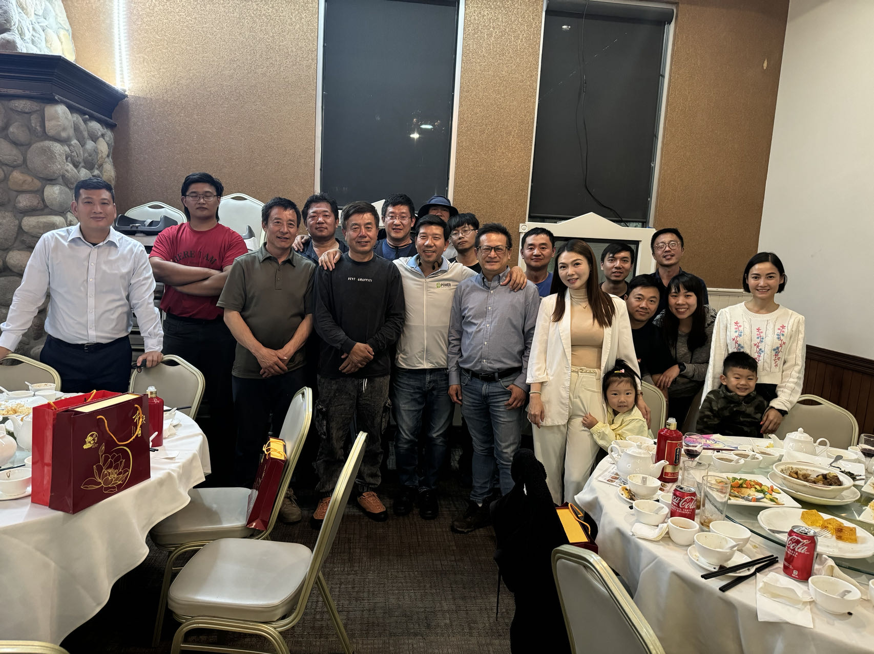
Work Life Harmony!

Slide 8
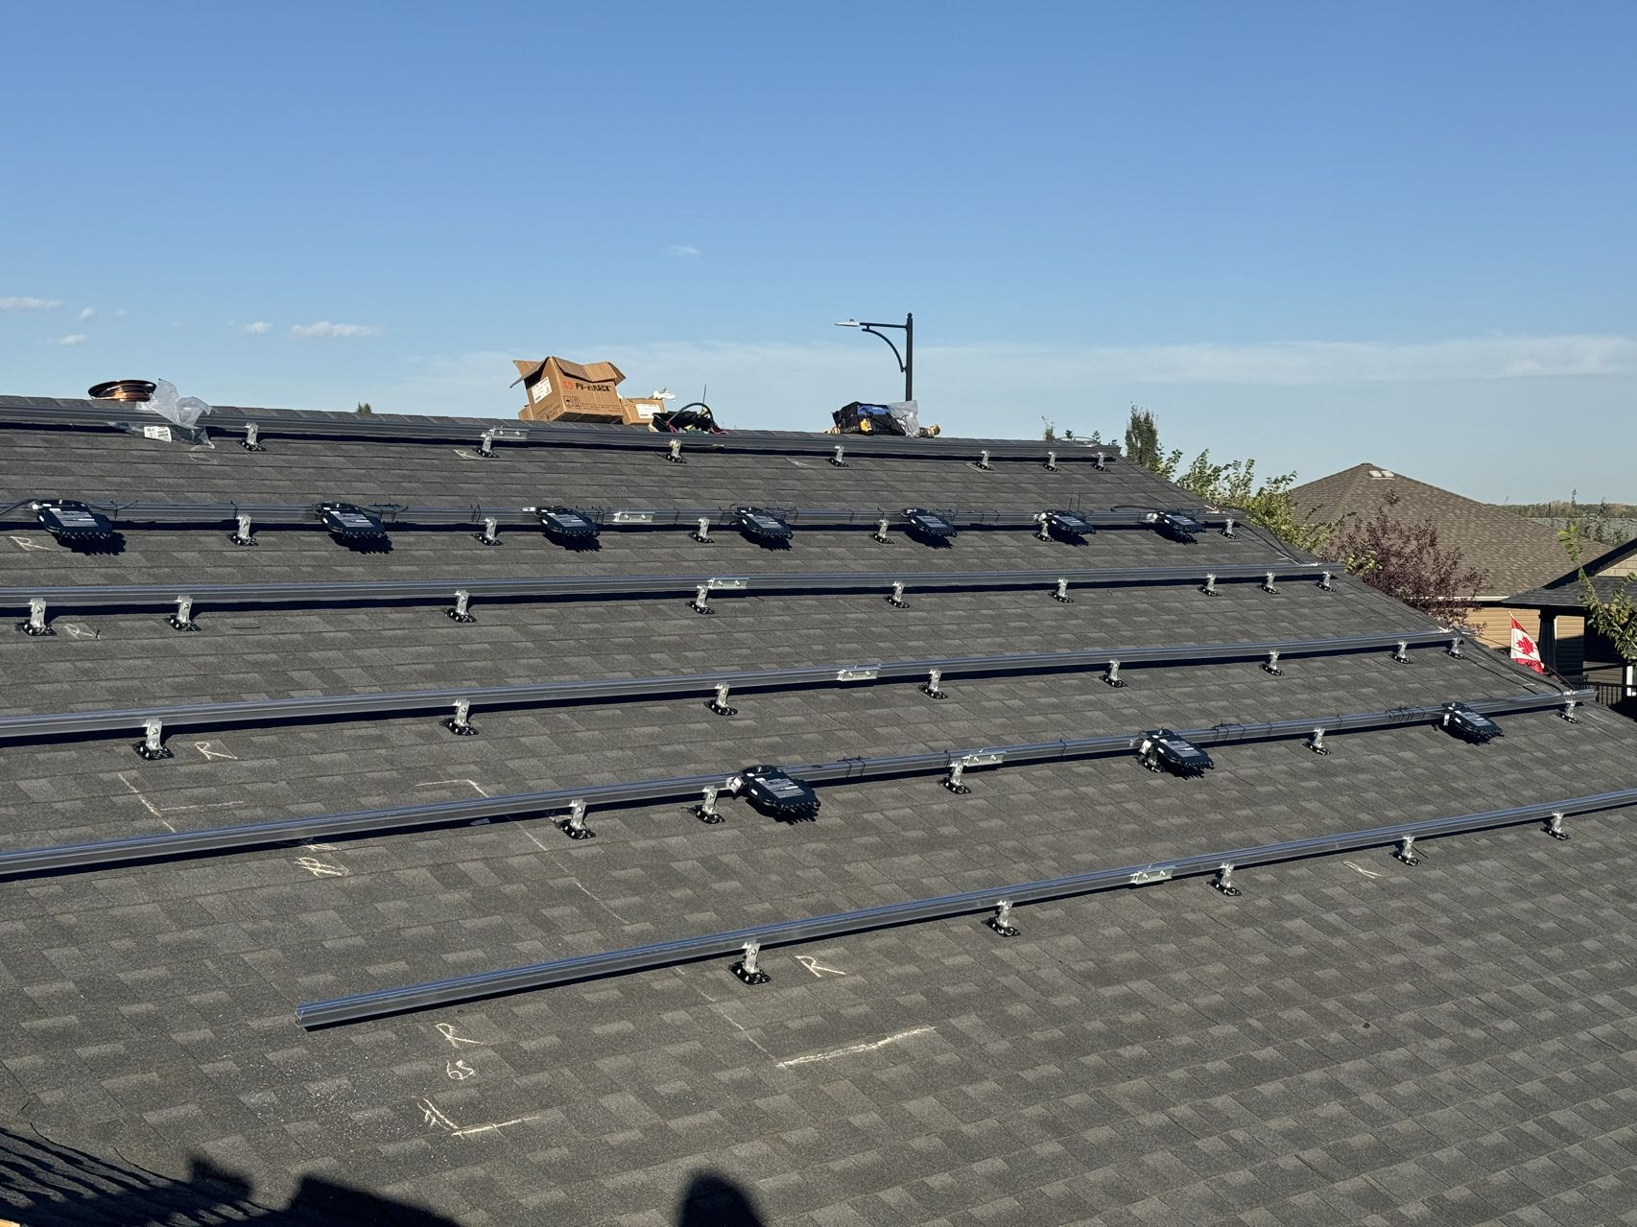
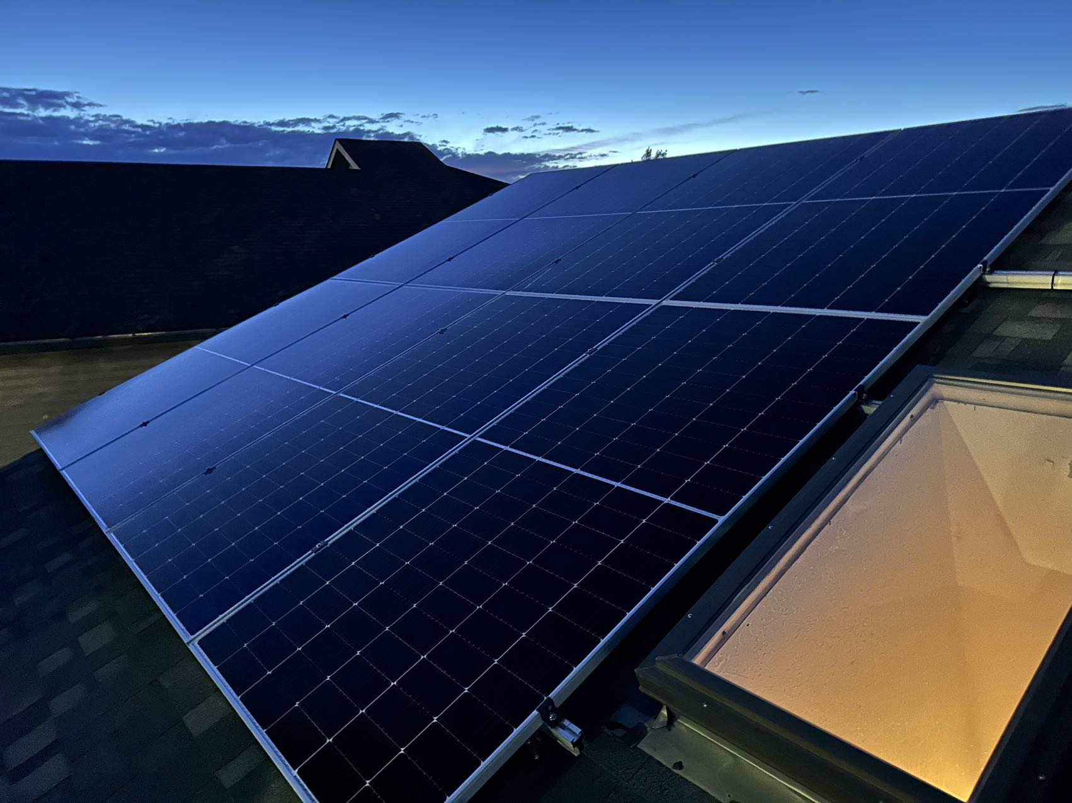
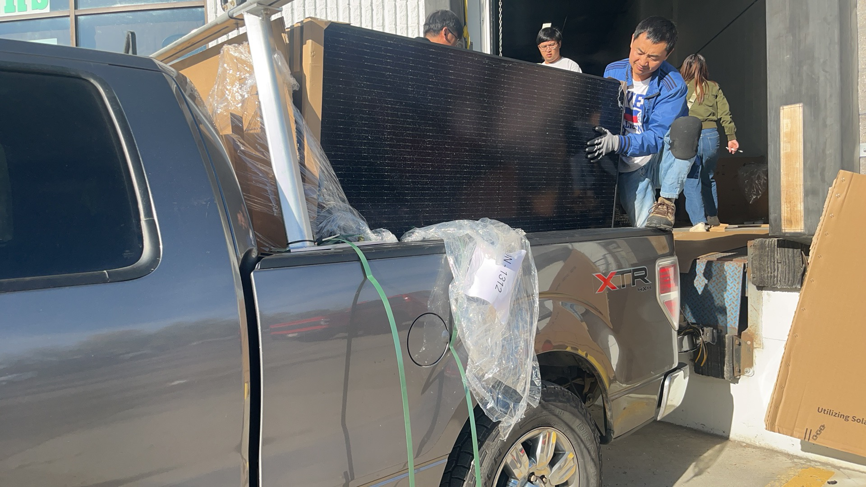
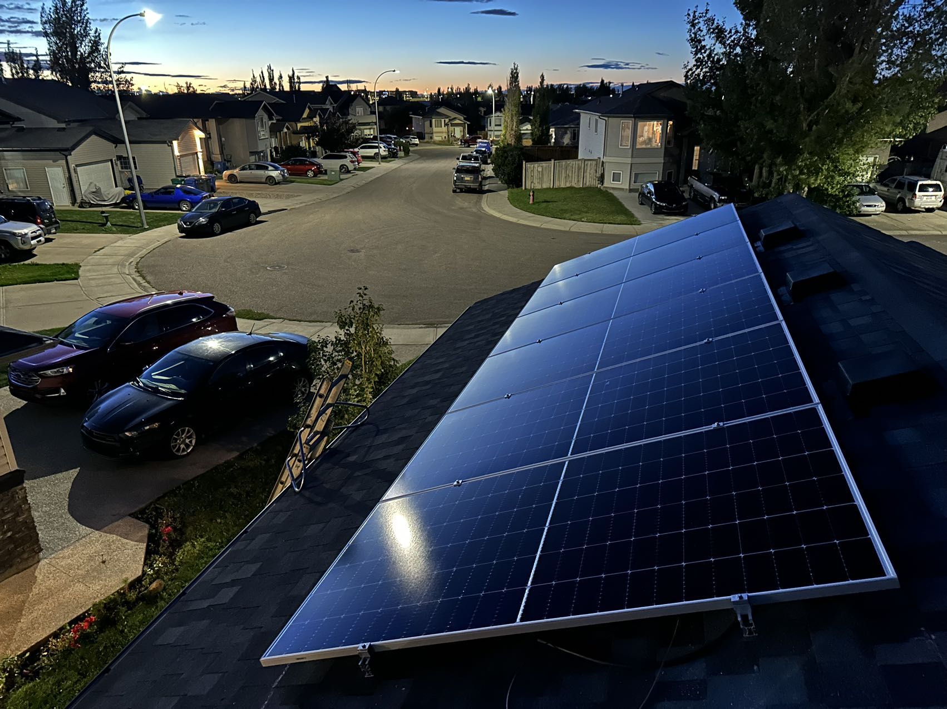
Solar Projects

Slide 9
Software Requirement
Inventory Control
Vendor Database
Customer Database
Survey Tracking
Installation Scheduling/Tracking
Electrical Inspection Tracking
Installation Scheduling
Financial System Website
Procurement
Account Receivable
Account Payable

Slide 10
Software Design Specification (SDS)
ERP System for Mobile and Web Applications

Slide 11
Objective
Design an ERP system that controls the following departments and areas, with support for iOS, Android Apps, and a website:
nventory Control
Vendor Database
Customer Database
Survey Tracking
Installation Scheduling/Tracking
Electrical Inspection Tracking
Financial System Website
Procurement
Accounts Receivable
Accounts Payable

Slide 12
System Architecture
The ERP system will use a microservices-based architecture, featuring:
Frontend: React Native for iOS/Android Apps, React.js for Web
Backend: Node.js with Express or Python Django
Database: PostgreSQL or MySQL, with MongoDB for unstructured data
Caching: Redis for caching frequently accessed data
Cloud Infrastructure: AWS, Azure, or Google Cloud
Scalable and Modular Design with Kubernetes for orchestration

Slide 13
UI/UX Design
Key UI/UX principles include:
Consistency: Uniform design elements across platforms
Responsiveness: Web application should be responsive to mobile and desktop
Simplicity: Easy navigation, minimal clicks to complete actions
Accessibility: Ensure WCAG compliance for users with disabilities
Cross-platform design using:
Material Design for Android
Apple’s Human Interface Guidelines for iOS

Slide 14
Key Features by Department
Inventory Control: Real-time stock tracking, barcode scanning
Vendor and Customer Database: Detailed records with advanced search
Survey Tracking: GPS location logging, image uploads
Installation Scheduling: Calendar view with real-time progress updates
Electrical Inspection Tracking: Upload certificates, log inspection results
Financial System: Accounts receivable/payable, invoice generation
Procurement: Automated purchase orders, supplier management

Slide 15
Security and Scalability
Security Features:
OAuth 2.0 with JWT for authentication
Role-Based Access Control (RBAC) for user permissions
Data Encryption using AES-256 for sensitive information
Scalability Considerations:
Cloud-based infrastructure for scaling
Autoscaling using Kubernetes and Docker containers
Load balancing using AWS ELB or NGINX

Slide 16
Conclusion
This ERP system is designed to streamline operations across departments with mobile and web support, providing a scalable, secure, and efficient solution for managing business processes like inventory control, scheduling, and financial management.

Slide 18
Software Development Specification (DNS SDS)
Deep Neural Solar's Microinverter Project

Slide 19
Confidentiality
This document contains proprietary & confidential information regarding the software design specification and revision control processes of Deep Neural Solar Inc. All information within this document is strictly confidential. Unauthorized disclosure, duplication, or distribution may result in legal action. By accessing this document, you agree to adhere to the terms of confidentiality outlined herein.

Slide 20
Overview
Deep Neural Solar’s microinverter is designed to integrate with home automation systems using agents-based neural networks.
It will perform decentralized tasks such as bitcoin mining during idle cycles.
This specification outlines the system's software architecture, features, and scalability through IoT integration.

Slide 21
Goals and Objectives
Implement agents-based neural network system for home automation.
Use IoT to manage real-time actions without complex algorithms.
Utilize idle computational cycles for bitcoin mining.
Integrate anti-islanding power generation safety mechanisms.
Facilitate communication using PowerLine technology.
Incorporate fintech solutions for secure financial transactions.

Slide 22
System Architecture - Hardware Components (MVP)
Microinverter: Main processing unit managing solar energy with limited computational capabilities.
Pi Zero with OpenAI: Lightweight platform running agents and neural networks.
Distributed Terminal Unit (DTU): Offloads complex tasks and manages communication between microinverters.

Slide 23
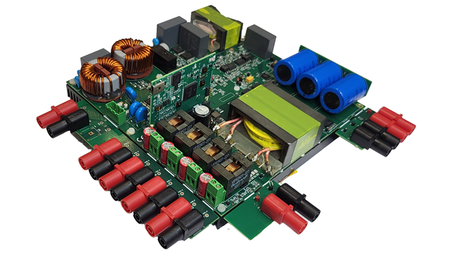
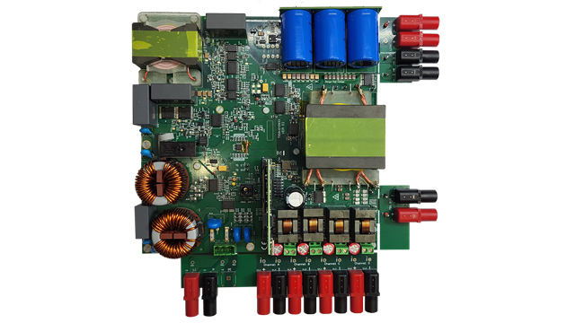
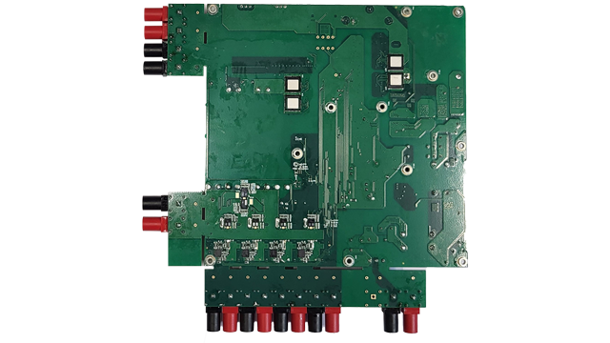
System Architecture - Communication Protocols
• PowerLine Communication (PLC): Enables data transfer via electrical wiring.
• IoT Protocols: MQTT or HTTP/REST for communication with home automation systems.

Slide 24
Software Components
1. Agent-Based Neural Network for home automation, solar power management, and bitcoin mining.
2. OpenAI Agent Management for learning and adapting to energy patterns.
3. Anti-Islanding Protection for safe grid disconnection.
4. Fintech Integration for energy trading and mining payments via blockchain.
5. Bitcoin Mining during idle time for profit generation.

Slide 25
Data Flow
1. Task Assignment: DTU assigns tasks to microinverters based on available resources.
2. Execution: Microinverters execute tasks and report results to the DTU.
3. Feedback Loop: System optimization through task result analysis.
4. Blockchain Transactions: Track energy generation and mining activities.

Slide 26
IoT Integration & Key Features
IoT Integration: Seamless integration with home automation platforms: (Google Home, Alexa, etc.).
Key Features:
Agent-based neural networks for task execution.
Bitcoin mining during idle time.
PowerLine communication for minimal additional cabling.
Blockchain integration for secure transactions.

Slide 27
Technical Requirements
Programming Languages: Python, C/C++, Go, Node.js.
Operating Systems: Linux-based (Raspberry Pi Zero), Embedded OS for inverters.
Tools & Libraries: OpenAI API, TensorFlow Lite, MQTT/HTTP, PowerLine modules.
Deployment: Docker containers for scalability, DTU manages updates.

Slide 28
Conclusion
This specification outlines a cutting-edge system for home automation and bitcoin mining using Deep Neural Solar’s microinverters. With AI-driven efficiency, IoT integration, and fintech innovations, the system provides secure, scalable, and profitable energy solutions for modern homes.

Slide 29
Questions?

Slide 30
Vision Statement
"Revolutionizing Energy Solutions Through Innovation in AI and Solar Technologies“
At Deep Neural Solar., our vision is to lead the global transition to sustainable energy by integrating advanced solar technologies with cutting-edge artificial intelligence. We aim to empower businesses and homeowners with intelligent, efficient, and renewable energy solutions, creating a smarter, cleaner, and more sustainable world. Through constant innovation, we envision a future where solar energy and AI-driven insights drive optimal energy use and environmental stewardship.

Slide 31
Mission Statement
"To Deliver Intelligent Solar Solutions that Optimize Energy Efficiency through AI Innovation“
At Deep Neural Solar., our mission is to design &deliver solar energy products and services that combine the power of artificial intelligence with renewable energy systems.
We are committed to:
Providing innovative, high-quality solar solutions that harness AI for predictive maintenance, energy optimization, and cost savings.
Educating and empowering customers to adopt smart energy practices, contributing to a sustainable future.
Continuously improving our technology to make solar energy more accessible, reliable, and efficient for every user, from individual households to large commercial enterprises.
Together, we aim to transform the energy landscape by making solar energy smarter and more sustainable, ensuring a positive impact on both our customers and the environment.

